Slide 1


Saint Paul’s School
Wolves

Slide 2
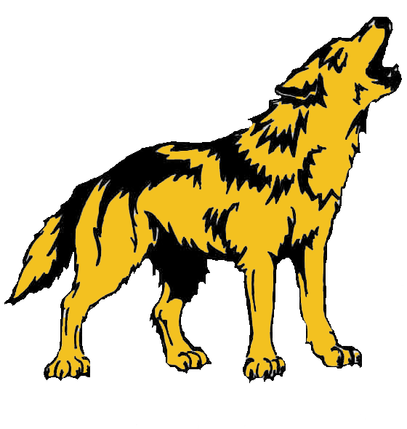
Saint Paul’s School
Wolves

